Slide 1


Confidential. For academic purposes only.
STOCKBUSTERS
Understanding Economic Shocks
06-Dec-2023
Brigid Sax | Delvin Eluvathingal | Nan Liu | Navneeth Oruganti | Rakshanda Hedawoo | Saketh Gangavaram | Sumedh Tirodkar

Slide 2


#Stockbusters
Economic Shock
an event that occurs outside of an economic model that produces a significant change within an economy
3 Timeframes of interest .
Lockdown 1
Lockdown 2
Russia-Ukraine War

Slide 3
Financial Terms used in this analysis . . .
1
INDEX
A price value indicator representative of the performance of the underlying sector
2
RELATIVE INDEXING
A method of rebasing the prices of all stocks / sectors in our analysis to 100 at the start date of analysis
3
BOLLINGER BANDS
A technical analysis method to observe OVERSOLD and UNDERSOLD signals in the market
4
VOLATILITY
The standard deviation of a market or security’s price over a given period
5
HEADWIND / TAILWIND
Headwind is and EXTERNAL NEGATIVE effect | Headwind is and EXTERNAL POSITIVE effect

Slide 4
Summary of work done
Explore | Verify | Export | Import | Observe | Clean | Sanitize | Brainstorm | Formulate | Execute | Lockdown 1 | Lockdown 2 | Ukraine War | US Markets | Tech Sector | Amazon
Gathering Stock Data |  |  |  | Cleaning up stock data |  |  | Creating Sector Level Indicators |  |  | Exploring trends in timeframes of interest |  |  | Interpreting Results into a story
 |  |  |  | Data Processing |  |  |  |  |  | Data Analysis
1
2
3

Slide 5




Setting up the ground for our analysis
SECTORS OF INTEREST
QUESTIONS OF INTEREST
Information Technology (Tech)
Pharmaceuticals (Pharma)
Telecommunications (Telecom)
Consumer Staples (FMCG)
How did economic shocks impact the price movements of the top 5 stocks in each sector
In what ways did these sectors respond to the challenges and opportunities posed?
How to identify headwind /tailwind effect?
To what extent did tech sector deviate from the expected behavior?
Are there any anomalies that stand out?
Is Tech sector witnessing a permanent paradigm shift?
STOCKS COVERED
+20 more

Slide 6


Gathering Data Needed for this analysis
APPROACH
DATA SOURCES
For us to analyze a market, sector or a stock, we need at least one metric that is available at a daily frequency
Stock / Security Price is indicative of both the fundamental value and perceived value
Identified 5 largest stocks in each sector
Created our own sector level indicators (Indexes)
Sector indexes are used as a proxy for the performance of that sector
Yahoo finance has stock price data of all stocks trading in the US
It is a reliable and an efficient source
Market watch:
Market watch has data related to stocks and indexes
We relied on this data set for our global indexes i.e. S&P500 and DJIA

Slide 7
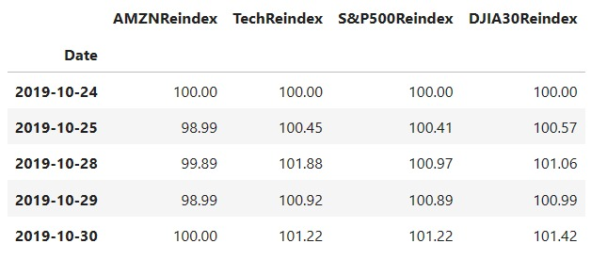
Processing Data
CONSTRUCTING SECTOR INDICES
REINDEXING STOCKS / SECURITIES
Why? To get one daily metric that is indicative of the entire sector
How? Equal price weightage to the largest 5 stocks in each sector Next day_{Reindexed} = Prev day_{Reindexed} * Next day_{Stock} / Prev day_{Stock}
Why? Called multiple times for each timeframe
How? Mapping through the columns of each stock / security to calculate the next day’s value Next day_{Reindexed} = Prev day_{Reindexed} * Next day_{Stock} / Prev day_{Stock}
OUTPUT

Slide 8
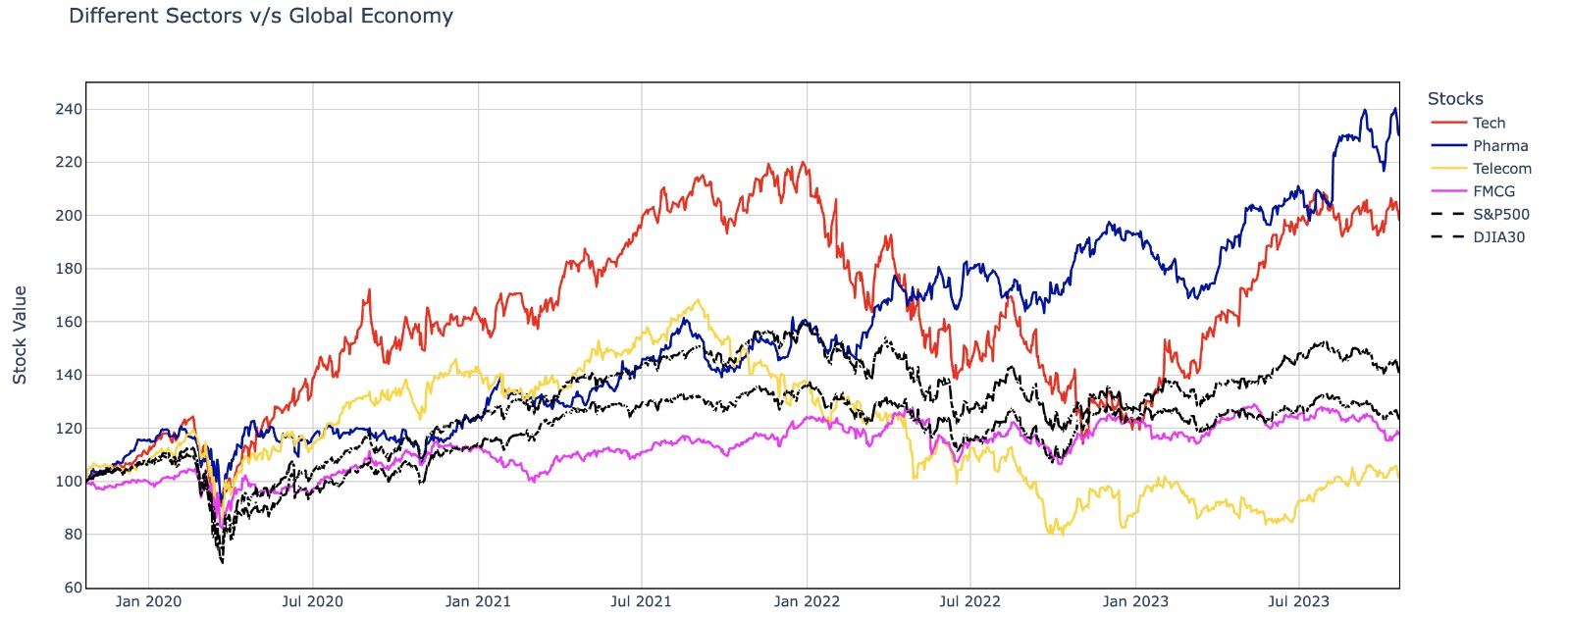
Performance of each sector relative to global economy
VISUALIZATION
OBSERVATIONS
Four sectors and global indices in a time series plot from Jan 2020 to Jul 2023
Tech sector is outperforming the global as well as the other industries' indices.
the tech industry flourished as the stock prices of all other businesses crashed during Covid
INFERENCES
Rise in the Tech sector can be attributed to aggressive digitization and the fact that more people were working from home
Over hiring during the COVID period resulted in crash in prices post the Ukraine war due to a recession in the US economy

Slide 9
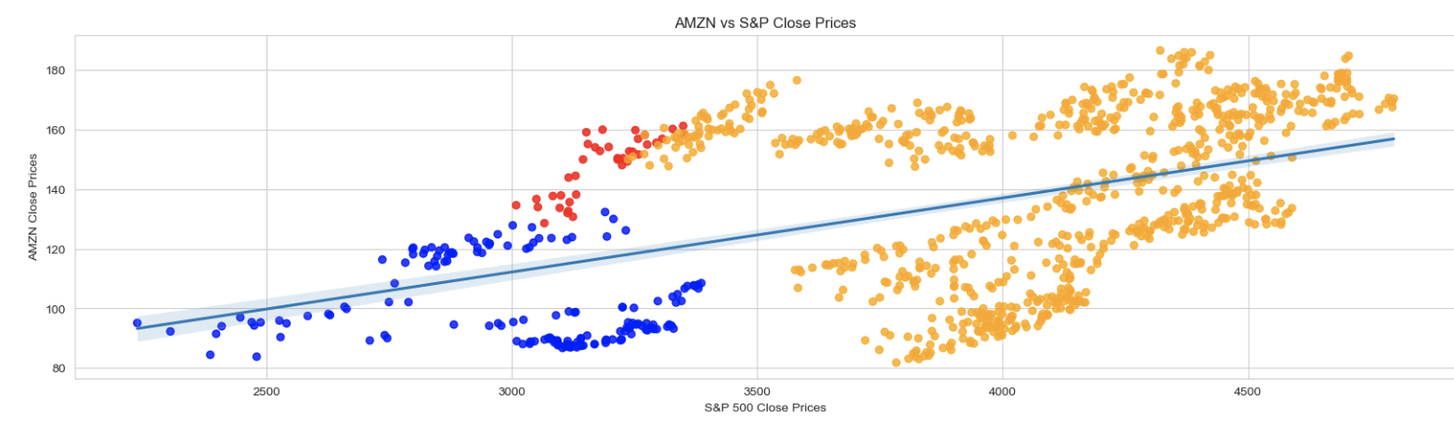
Amazon vs Global Economy
VISUALIZATION
OBSERVATIONS
Amazon's stock witnessed nearly twofold increase during the initial wave of the COVID-19 pandemic.
The center portion of graph is displaying abnormally high deviation
Clear and consistent skewness towards amazon during lockdown 2
INFERENCES
Amazon was well prepared for lockdown 2
They made the most of it resulting in actual value that is much higher than the
Additionally, AWS reported high profits during this phase

Slide 10
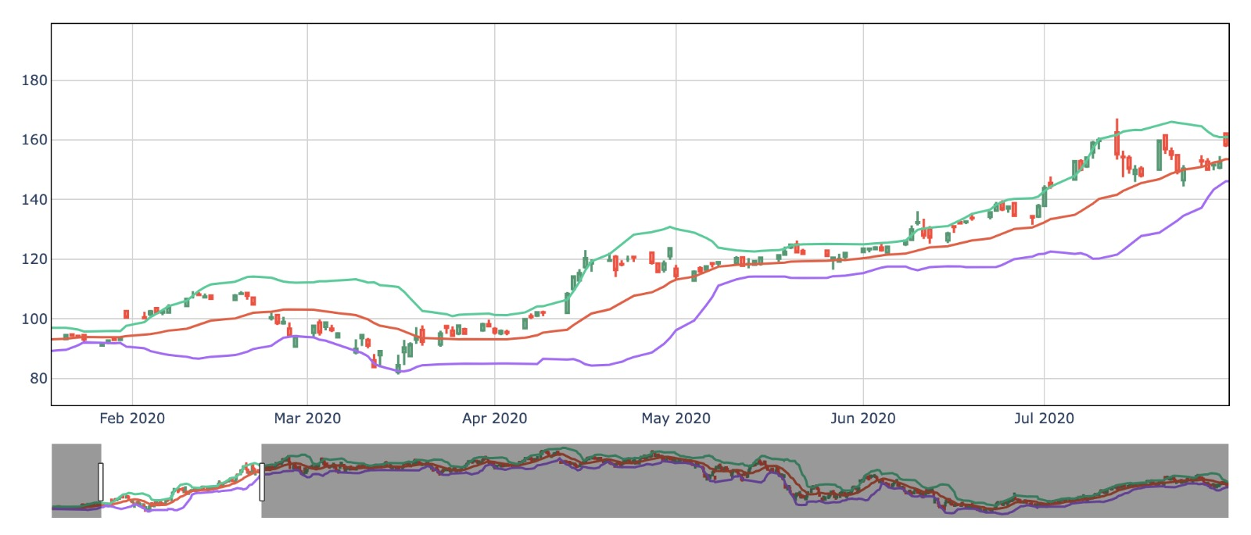
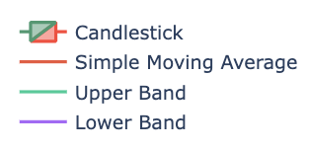
Understanding volatility in Amazon
VISUALIZATION
OBSERVATIONS
First 2 weeks after announcement of lockdown 1 showed abnormally high volatility in the market
Support was missing although the stock hit lower band multiple times
1. Amazon's stock price oscillates within the Bollinger Bands, indicating inherent tech sector volatility.
2. The pandemic initially fueled Amazon's growth due to increased online activity, reflected in wider Bollinger Bands.
3. Post-pandemic adjustments and supply chain disruptions caused stock price fluctuations and narrowed the bands.
INFERENCES
This is the anticipation phase and most investors were panicking about their holdings in all stocks
Herd behavior – Although a strong buy signal is seen form the graph, the required support did not come from the potential buyers
1. This indicates that the stock was oversold, which can seem like an indicator to buy because of the low price.
2. When the price shot up, hugging the upper band it is typically a sign that one should sell their stock, as the price will soon decrease
3. The war shifted consumer priorities, leading to reduced spending on non-essential items. This impacted Amazon's core retail business and contributed to a narrowing of the Bollinger Bands as market volatility subsided

Slide 11
Summing it up
TECH SECTOR
OTHER SECTORS
Tech sector has recovered strong from lockdown 1
The tailwind effect noted seems to be a permanent shift
Our research shows that the factors driving the changes are strongly correlated to the indicators we have used
Correction in prices (as seen in Analysis 2) last year appears to be due to over hiring during the lockdown 1
Tech sector seems to benefit the most from economic shocks and we expect this trend to recur
Pharma: Benefitted the most in short term
Telecomm: Suffered due to supply chain disruption during the war. Expected to take years to recover
Consumer Staples: Recession proof but not resilient to economic shocks
AMAZON
Amazon is a tech and a consumer company
All its 3 major business segments were in steep demand during lockdown 1
Suffered from supply chain issues during the Ukraine war (Explains drop in tf3)

Slide 12
REFERENCES
Professor's notebooks for guidance across the notebook
For Plotly Candle stick graphs - https://plotly.com/python/candlestick-charts/
For Plotlty Line Graphs - https://plotly.com/python/line-charts/
DATA SOURCES
https://finance.yahoo.com/
https://www.marketwatch.com/
CITATIONS
Research for AMZN - 10 Q for lockdown 1 period - https://www.sec.gov/Archives/edgar/data/1018724/000101872420000021/amzn-20200630.htm
Research for AMZN - 10 K for 2020 -
https://www.sec.gov/Archives/edgar/data/1018724/000101872421000004/amzn-20201231.htm
McKinsey Report - To understand impact of Covid - https://www.mckinsey.com/capabilities/strategy-and-corporate-finance/our-insights/how-covid-19-has-pushed-companies-over-the-technology-tipping-point-and-transformed-business-forever
Financial Edge - To understand Rebasing / Reindexing - https://www.fe.training/free-resources/asset-management/rebasing-stock-prices-to-100/

Slide 13
THANK YOU
THE END
A story by Stockbusters
QUESTIONS?

Slide 14
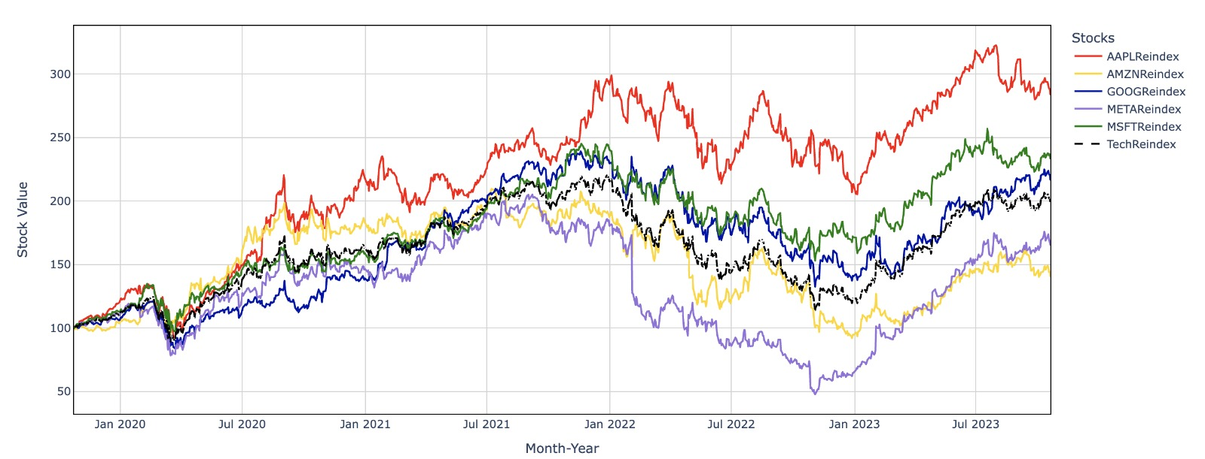
II – A deeper look into the tech sector
VISUALIZATION 2
OBSERVATIONS
After an initial setback, During the pandemic period all the tech companies prospered
We see a dip in the stock prices of Meta during the Russia-Ukraine war period.
Amazon's stock price has outperformed even the TechReindex since the start of the pandemic
INFERENCES
Amazon’s surreal growth is due to sudden rise in demand for all its 3 major business segments
Meta's stock price surge can be attributed to a combination of factors, including a strong rebound from a previous decline, successful cost-cutting measures.
Tech companies are well positioned to ride digitization forced by Covid

Slide 15
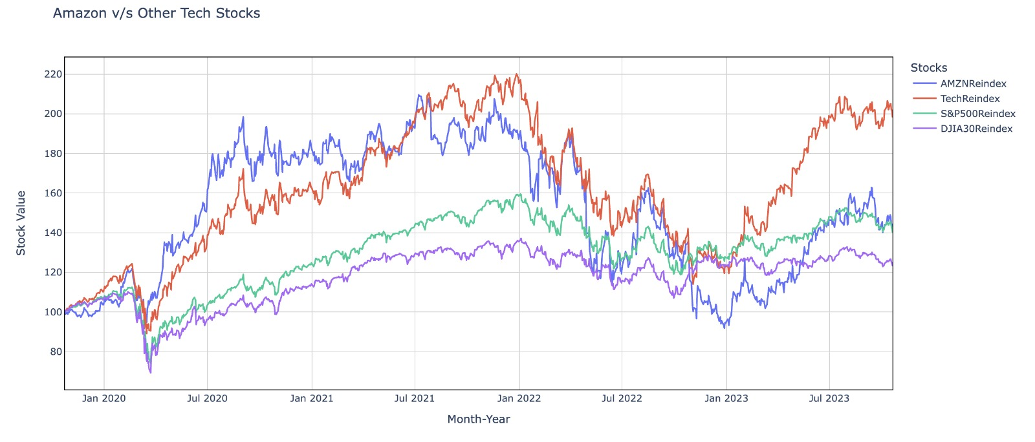
III – Amazon vs Other Tech Stocks
III – Amazon vs Other Tech Stocks
VISUALIZATION 3
3: AMZN vs other tech stocks
OBSERVATIONS
OBSERVATIONS
Tech Sector Outperformed
Initial downturn and tech rebound including Amazon
Widening performance gap
INFERENCES
INFERENCES
E-commerce, Entertainment & AWS as Dire Requirements
Tech Sector & Digitization Significance
Digitization Impact on Activities
Amazon stood-out as a standalone performer

